Slide 1
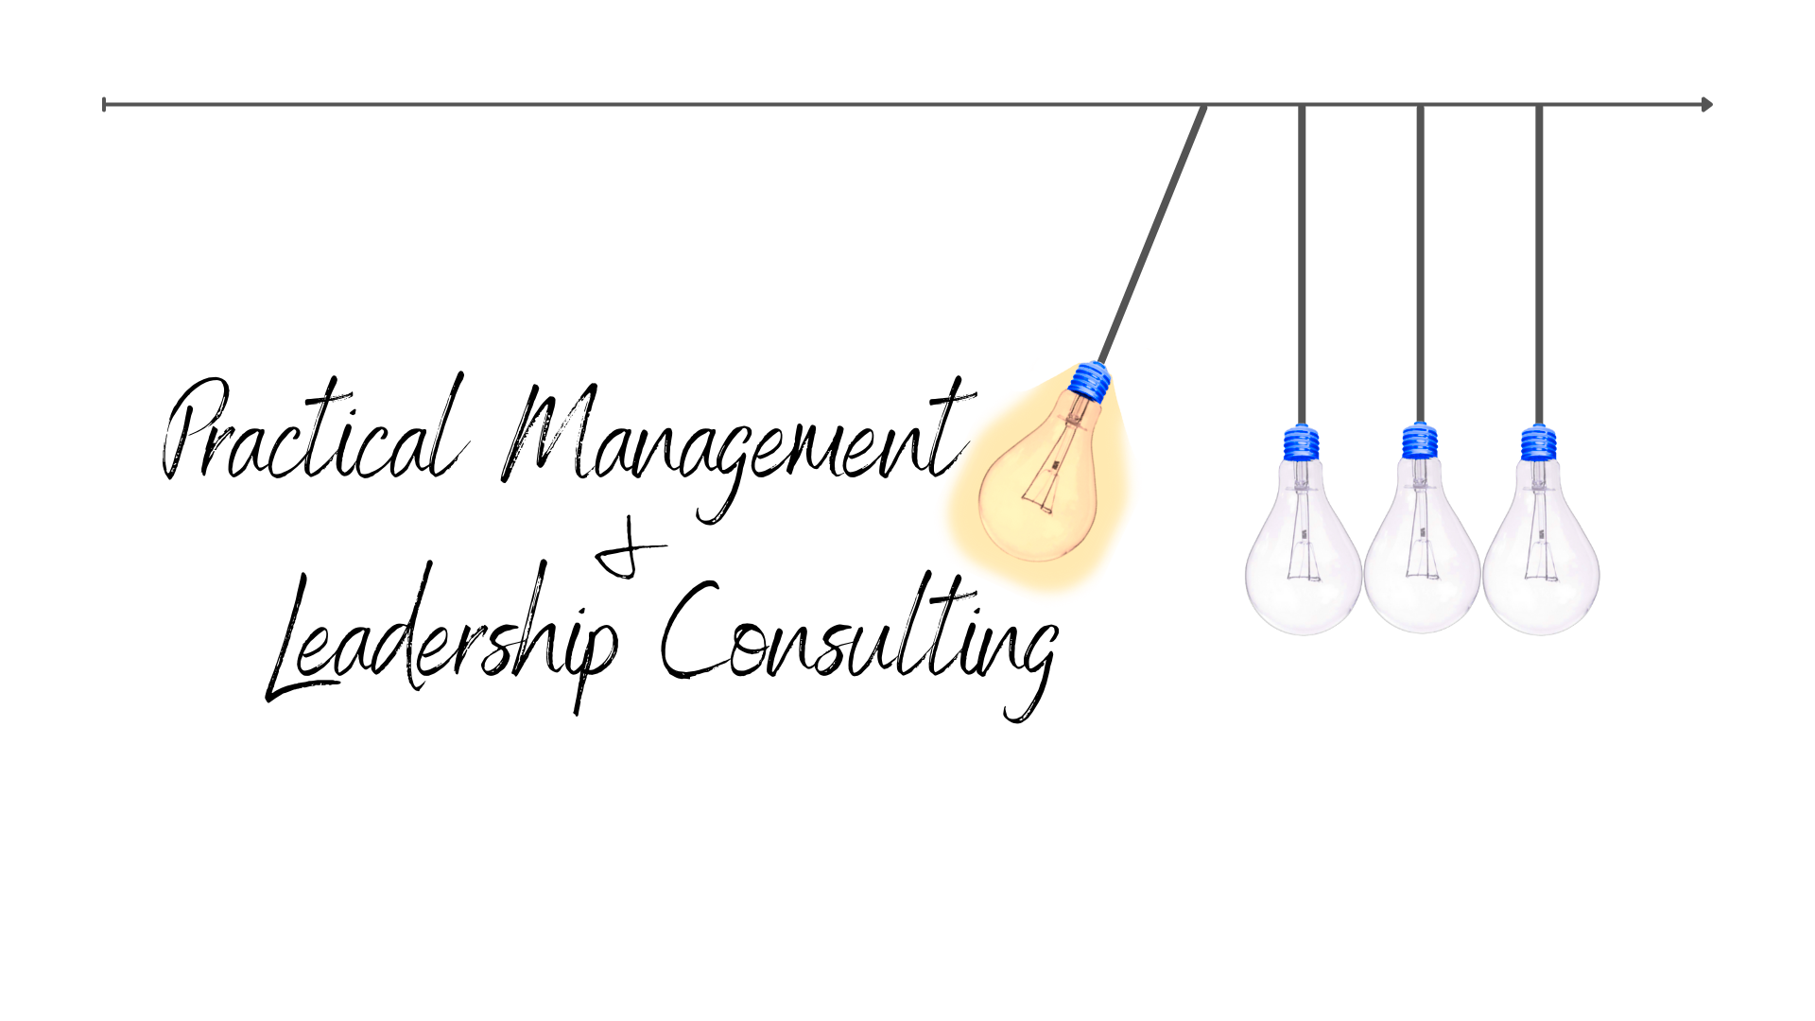
Understanding and Dismantling our Biases

Slide 2
Resources
Implicit Assessment Test (IAT) (Harvard)
National Center for Cultural Competence (NCCC, Georgetown) Bias Primer
State of Science on Unconscious Bias
National Standards for Culturally and Linguistically Appropriate Services in Healthcare
“Hidden Brain” podcast hosted by Shankar Vedantam

Slide 3
Resources (continued)
Achieving Health Equity (whitepaper)
Unequal Treatment (whitepaper)
Cognitive Bias: Recognizing and managing our unconscious biases (whitepaper)
Anti-Racism Beginner’s Guide Google doc compiled by A. Dasgupta, New York, NY, June 2020
All In The Mind (Cognitive Sciences podcast)
Kirwan Institute for the Study of Race and Ethnicity at OSU

Slide 4
Additional Reading
Blind Spot: Hidden Biases of Good People by Mahzarin Banaji and Anthony Greenwald
Biased: Uncovering the Hidden Prejudice That Shapes What We See, Think, and Do by Jennifer Eberhardt
Blink: The Power of Thinking Without Thinking by Malcolm Gladwell
How To Be An Antiracist by Ibram X. Kendi
So You Want To Talk About Race by Ijeoma Oluo
White Fragility by Robin DiAngelo

Slide 5
Additional Reading
The Memo by Minda Harts
We Are Everywhere: Protest, Power, and Pride in the History of Queer Liberation by Matthew Riemer and Leighton Brown
“Misconceptions, Misinformation, and the Logic of Identity-Protective Cognition” (& other papers) by Dan Kahan
Thinking, Fast and Slow (& papers) by Daniel Kahneman
Judgment Under Uncertainty: Heuristics and Biases by Daniel Kahneman, Paul Slovic, & Amos Tversky

Slide 6
Additional Reading (continued)
Mistakes Were Made (but Not by Me): Why We Justify Foolish Beliefs, Bad Decisions, and Hurtful Acts by Carol Tavris & Elliot Aronson
Works by Richard Thaler & Cass Sunstein
Books and resources (particularly for those leading Gifted Youth programs) from Gail Thompson at www.drgailthompson.com
Heads of the Colored People: Stories by Nafissa Thompson-Spires

Slide 7
TED/TEDx
Dr. Ibram X. Kendi: The Difference Between Being Not Racist and Being Anti-racist (TED Interview, June 2020)
Kristin Pressner: Are You Biased? I Am. (TEDxBasel, May 2016)
Melanie Funchess: Implicit Bias -- how it effects us and how we push through (TEDxFlourCity, Oct 2014)
Denise Hernandez: Unpacking and Transforming Your Biases For A Better Community (TEDxSanAntonio, Apr 2016)
Kori Carew: Just Belonging - Finding the Courage to Interrupt Bias (TEDxYouth@KC, Mar 2018)
Valerie Alexander: How to Outsmart Your Own Unconscious Bias (TEDxPasadena, Oct 2018)
Notes:
For more great talks, go to Ted.com and search for specific keywords like bias, implicit or unconscious bias, racism, sexism, etc.

Slide 8
Probing Questions to Confront Bias
Do my biases:
Impact the amount of time I spend with others?
Influence how I communicate with others?
Hamper my capacity to feel/express empathy toward others?
Interfere with my capacity to interact positively with others?
Notes:
As you contemplate each question, consider factors such as age, race, ethnicity, gender, sexual orientation, gender identity or expression, English language proficiency, socioeconomic status, literacy, or body size.

Slide 9
Probing Questions to Confront Bias
Do you know (or believe) that those with whom you routinely interact think that your attitudes and behaviors demonstrate bias? If so, are you open to discussing these issues with them to elicit their point of view?
Has anyone, directly or through satisfaction surveys, raised concern about attitudes in your organization or the way you communicate with them?
Notes:
As you contemplate each question, consider factors such as age, race, ethnicity, gender, sexual orientation, gender identity or expression, English language proficiency, socioeconomic status, literacy, or body size.

Slide 10
Probing Questions to Confront Bias
Do you ever perceive that you are less comfortable with others who are different than you? (Race/ethnicity, religion, sexual orientation, gender identity, or disability?)
What can you do to combat bias in your daily life?
Notes:
As you contemplate each question, consider factors such as age, race, ethnicity, gender, sexual orientation, gender identity or expression, English language proficiency, socioeconomic status, literacy, or body size.

Slide 11
Images Promoting Diversity
Devoted Specifically to Combatting Stereotypes:
Getty Images “Lean In Collection” (www.gettyimages.com/collections/leanin)
HuffPost Asian Stock Photos (https://tinyurl.com/22ac2xvb)
Women of Color in Tech (www.flickr.com/photos/wocintechchat)
Wide Variety (So Easier to Find Images That Combat Stereotypes):
DesignersPics (www.designerspics.com)
Google Images (www.google.com/imghp; after search click Tools > Usage Rights)
Pixabay (www.pixabay.com)
The Public Domain Project (www.pond5.com)
Stock Snap (https://stocksnap.io)
Unsplash (www.unsplash.com)
Videvo (www.videvo.net)
Visual Thinkery (www.visualthinkery.com)
Notes:
For more great talks, go to Ted.com and search for specific keywords like bias, implicit or unconscious bias, racism, sexism, etc.

Slide 12
Jessica Ellis-Wilson, CMPE 774-678-1033 jess@pmalconsulting.com

